Slide 1
ARREST & INTERROGATION – THE ROLE OF THE LEGAL PRACTITIONER
FACILITATOR - EDOKA DOX ONYEKE

Slide 2
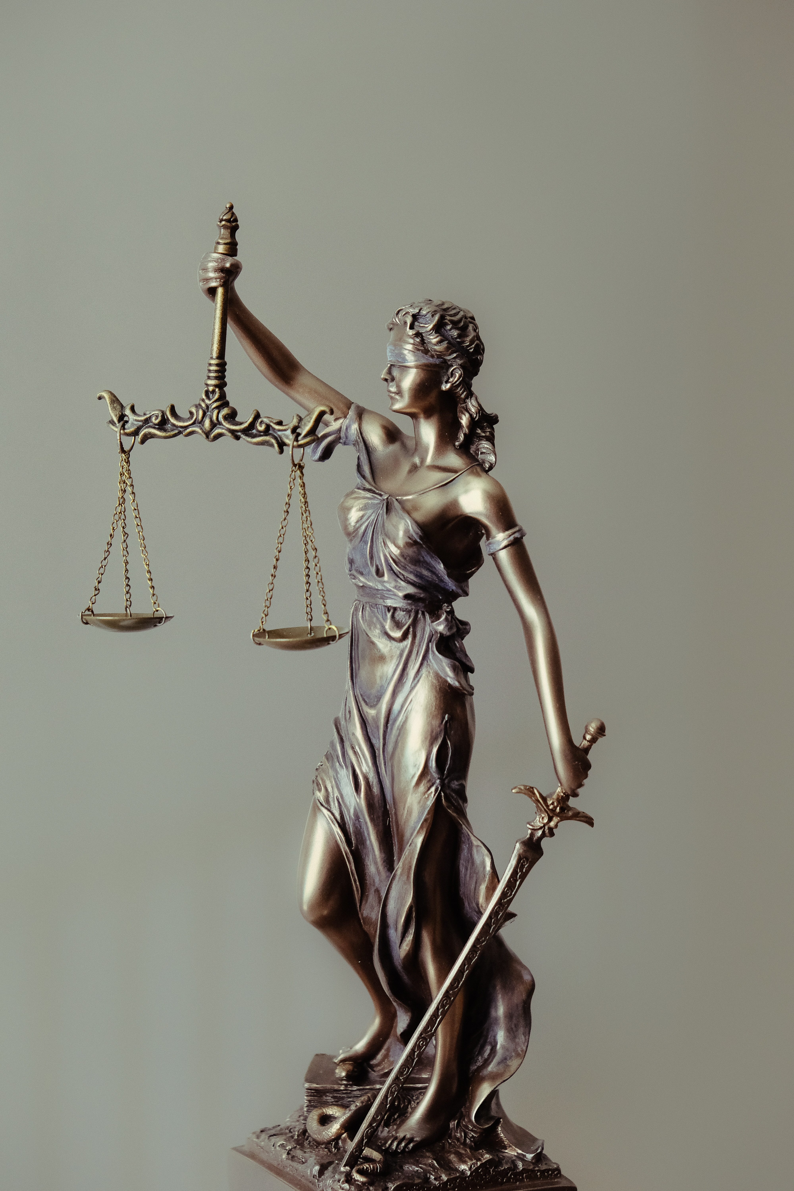
INTRODUCTION
THE RIGHT TO ARREST, DETAIN AND INTERROGATE PERSONS BY LAW ENFORCEMENT AGENCIES IS CONSTITUTIONAL AND STATUTORY.
THE CONSTITUTIONAL & STATUTORY RIGHTS OF PERSONS ARRESTED, DETAINED AND INTERROGATED TO A LEGAL PRACTITIONER OF THEIR CHOICE IS ALSO GUARANTEED UNDER SECTION 35 (2) OF THE 1999 CONSTITUTION OF THE FEDERAL REPUBLIC OF NIGERIA (AS AMENDED); SECTION 6 (2)(a), (b) & (c) OF THE ADMINISTRATION OF CRIMINAL JUSTICE ACT, 2015 & SECTION 9 (2) & (3) OF THE ADMINISTRATION OF CRIMINAL JUSTICE LAW OF LAGOS STATE, 2011.

Slide 3
THE PRACTICAL REALITIES ON HOW A LEGAL PRACTITIONER CAN EFFECTIVELY PERFORM HIS ROLE/LEGAL RESPONSIBILTY DURING INTERROGATION
2

Slide 4

THE OPTICS TO BE DEPLOYED BY A LEGAL PRACTITIONER.
COMPOSURE
COMPORTMENT
CARRIAGE
CHARM OFFENSIVE

Slide 5

SKILLS TO BE DEPLOYED FOR EFFECTIVE REPRESENTATION OF CLIENTS DURING INTERROGATION
PREPARE THE CLIENT FOR INTERROGATION.
AVOID AS MUCH AS POSSIBLE, ANY INTERFERANCE WITH THE ACTUAL INTERROGATION PROCESS.
DEVELOP A RAPPORT WITH THE INVESTIGATORS TO AVOID AND/OR MINIMIZE HOSTILITY DURING INTERROGATION.
DO NOT PROVIDE ANSWERS, AND/OR RESPOND TO QUESTIONS MEANT FOR YOUR CLIENT.
AVOID BEING SEEN THROUGH YOUR ACTIONS DURING INTERROGATION AS A CLOG IN THE WHEELS OF INVESTIGATION.
AVOID ANY ACTION THAT COULD RAISE ANY SUSPICION/OR LEAD TO ANY ADVERSE CONCLUSION ON YOUR ROLE/PRESENCE DURING INTERROGATION.

Slide 6

BE SUBTLE, CALM, FIRM AND RESPECTFUL IN THE COURSE OF ANY UNAVOIDABLE INTERVENTION DURING INTERROGATION.
DO NOT BE ARROGANT, UNNECESSARILY COMBATIVE AND/OR ENGAGE IN ARGUMENTS WITH INVESTIGATING OFFICERS DURING INTERROGATION, EVEN WHEN PROVOKED.
AVOID BEING CONSTRUED AS STUCK UP AND/OR FULL OF YOUR OWN IMPORTANCE, OR STANDING AS A LEGAL PRACTITIONER.
BE FLEXIBLE IN NAVIGATING ANY UNFRIENDLY ATTITUDE BY LAW ENFORCEMENT AGENTS.

Slide 7

EXHIBIT GOOD SOCIAL AND PERSONABLE SKILLS IN YOUR INTERRACTION WITH LAW ENFORCEMENT AGENTS AND THE INVESTIGATING OFFICER DURING INTERROGATION.
DO NOT BE CONSTRUED BY YOUR ACTIONS AS ATTEMPTING TO TAKE OVER THE INTERROGATION PROCESS, THE LAW ENFORCEMENT AGENCY OFFICE, IS NOT A COURT ROOM, WHERE OBJECTIONS AND ARGUMENTS ARE RAISED AND MADE.
ENDEAVOUR TO BUILD AND MAINTAIN GOOD WORKING RELATIONSHIP WITH LAW ENFORCEMENT AGENTS, YOU MAY NEED TO CALL ON SUCH RELATIONSHIPS IN FUTURE INSTRUCTIONS.

Slide 8
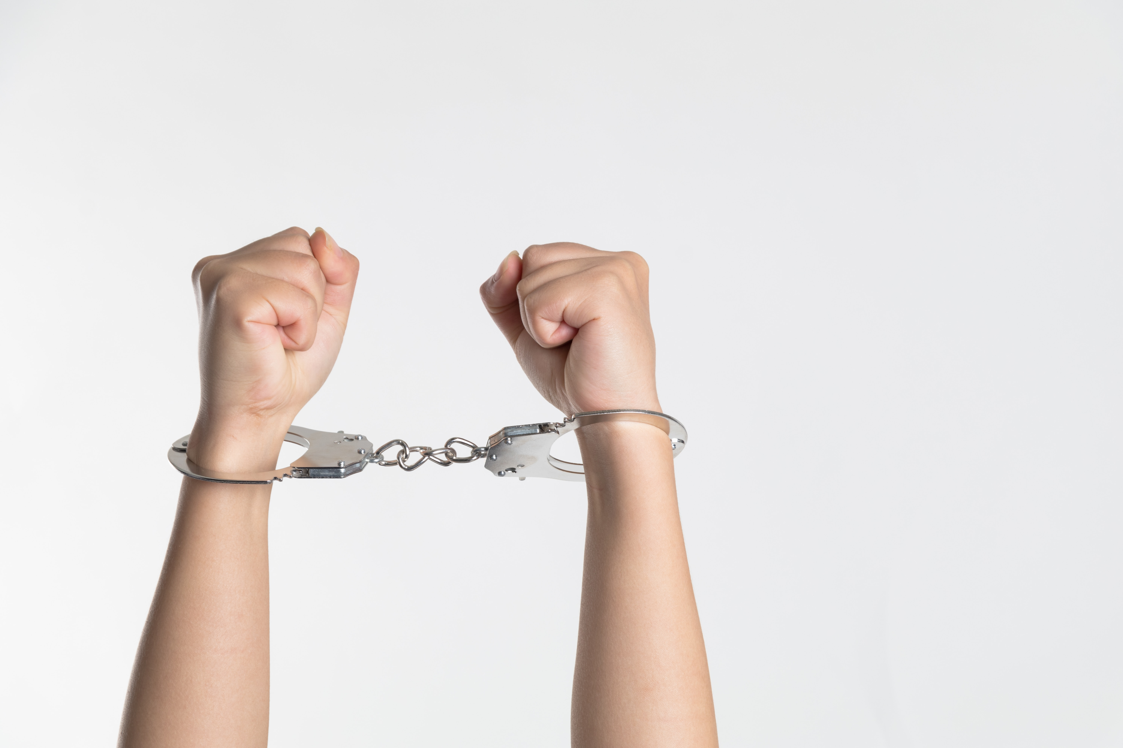
ADMINISTRATIVE BAIL
PREPARE AND PROVIDE PERSONS OF GOOD STANDING AND VERIFIABLE CREDENTIALS TO ACT AS SURETIES AHEAD OF TIME.
ESTABLISHMENT OF A GOOD RAPPORT WITH THE INVESTIGATING OFFICER WOULD BE OF GREAT ASSISTANCE IN THE ACCEPTANCE OF PERSONS PROPOSED AS SURETIES.
WHERE IT IS NECESSARY TO APPROACH A SUPERIOR OFFICER FOR APPROVAL ON PERSONS PROPOSED AS SURETIES, DO SO WITH RESPECT TO BOTH THE INVESTIGATING OFFICER AND THE SUPERIOR OFFICER.

Slide 9
ALWAYS LISTEN, BE PATIENT, LEARN AND UNDERSTAND ANY ISSUE RAISED AGAINST THE ACCEPTANCE OF THE PROPOSED SURETIES, BY EITHER THE INVESTIGATING OFFICER OR THE SUPERIOR OFFICER.
ENSURE YOUR CLIENT COMPLIES WITH THE CONDITIONS OF HIS/HER ADMINISTRATIVE BAIL, AS THIS WOULD ENSURE THAT THE NEXT TIME YOU HAVE CAUSE TO APPLY FOR BAIL OF ANOTHER CLIENT, YOU WOULD BE VIEWED FAVOURABLY.
WHERE THE BAIL CONDITIONS ARE ONEROUS, OFFER ACCEPTABLY CLOSE ALTERNATIVES IN A RESPECTFUL AND CALM MANNER.

Slide 10
ALWAYS REMEMBER THAT IT IS THE CLIENT THAT WOULD SUFFER, IF YOU DO NOT APPLY TACT, WISDOM AND PEOPLES’ SKILL IN SURMOUNTING ANY CHALLENGE TO HIS PERSONAL LIBERTY.
IT IS ALL ABOUT GETTING RESULTS FOR THE CLIENT, USING YOUR LEGAL AND SOCIAL SKILLS, DO NOT MAKE IT ABOUT YOUR EGO.

Slide 11


